Slide 1
The Impact of Perceived Economic Insecurity on Negative Attitudes Toward Immigrants in the World Value Survey Data
Armin Shoja Ardalan - Senior Capstone in Psychology
Professor - Heidi Toivonen
Franklin University Switzerland

Slide 2
Introduction
Intergroup relations and prejudice are fundamental issues in contemporary societies
Immigration attitudes studied within social psychology
Perceived economic insecurity → sense of competition over scarce resources
Immigrants are potentially perceived as an outgroup, even without direct competition

Slide 3
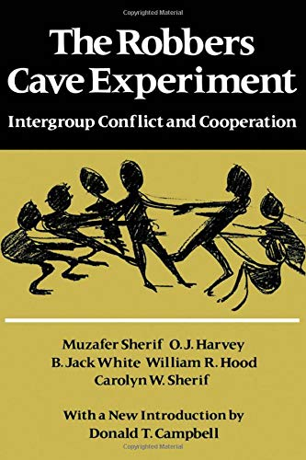
Background & Previous Research
Robbers Cave Experiment (Sherif & Sherif, 1954): intergroup hostility rises when resources feel scarce
Perceived scarcity ≠ real scarcity: perception is enough
Gap in literature: few cross-national, large-scale studies, as well as using the same variables in WVS

Slide 4
Research Question & Hypothesis
RQ: Does perceived economic insecurity predict negative attitudes toward immigrants?
H: Higher perceived economic insecurity leads to higher negative attitudes toward immigrants

Slide 5
Method
Quantitative, cross-sectional, correlational research design
Based on secondary data from the seventh wave (2017-2022) of the World Values Survey
IBM SPSS to analyze
5 countries selected: Australia, Canada, Jordan, New Zealand, and Singapore

Slide 6
Indices
Q50 “How satisfied are you with the financial situation of your household? Please use this card to help with your answer”
“To what degree are you worried about the following situations?” Q142 “Losing my job or not finding a job” Q143 “Not being able to give my children a good education”
Q21 “On this list are various groups of people. Could you please mention any that you would not like to have as neighbors?” (Immigrants/foreign workers).
Q34 “When jobs are scarce: employers should give priority to (nation) people over immigrants”

Slide 7
Case selection: filtered dataset for target countries
Data cleaning: defined missing values and recoded variables
Standardization: normalized variables with different measurement scales
Index construction: used the mean function to create composite indices for IV and DV
Statistical analysis: bivariate Pearson correlation to test the relationship

Slide 8
Correlation Results
Statistically significant positive relationship between Perception of Economic Insecurity and Anti-Immigrant Attitudes
r = .20
p < .001
N = 6,069
Takeaway: as economic anxiety increases, negative attitudes toward immigrants also tend to rise

Slide 9
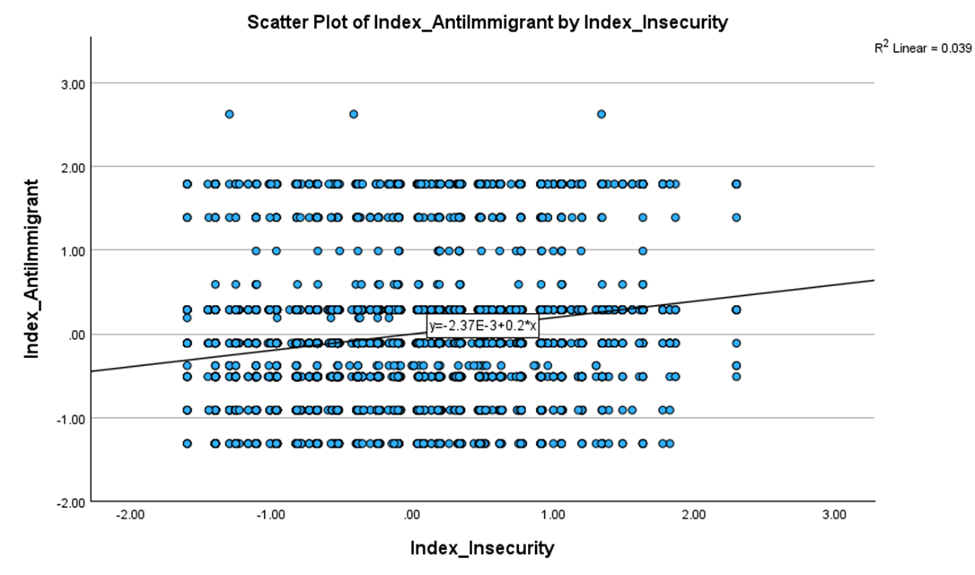

Slide 10
Results
Hypothesis: individuals who perceive to be economically at risk are more likely to have negative attitudes toward immigrants
Appears to be confirmed
Magnitude: while the relationship is weak-to-moderate, the high level of significance suggests this could be a consistent trend, rather than a random occurrence

Slide 11
Limitations and Future Research
Cultural and political context
Items could measure the variables more precisely
Controlling for “real“ economic situation
Longitudinal study
Using primary data or items from future waves
Multidisciplinary approach

Slide 12
Discussion and Conclusion
The effect is significant but moderate; economic insecurity is one piece of a larger social and psychological context
Other factors: cultural familiarity with diversity, social media exposure, political party framing, real economic situation, etc.
Perception can have severe consequences on social relations, awareness can potentially lead to less outgroup hostility

Slide 13
Thank you

Slide 14
References
Ahmed, S., Jaidka, K., Chen, V. H. H., Cai, M., Chen, A., Emes, C. S., Yu, V., & Chib, A. (2024). Social media and anti-immigrant prejudice: a multi-method analysis of the role of social media use, threat perceptions, and cognitive ability. Frontiers in psychology, 15. https://doi.org/10.3389/fpsyg.2024.1280366
Albarello, F., Moscatelli, S., Menegatti, M., Lucidi, F., Cavicchiolo, E., Manganelli, S., Diotaiuti, P., Chirico, A., & Alivernini, F. (2024). Prejudice towards Immigrants: A Conceptual and Theoretical Overview on Its Social Psychological Determinants. Social Sciences, 13(1), 24. https://doi.org/10.3390/socsci13010024
Campbell, T. D., & Levine, R. A. (1967). Psychological Versus Sociological Explanations of Ethnocentrism. American Psychological Association. Washington, D.C. https://eric.ed.gov/?id=ED018821
Gu, Y., Zhang, X. & Lin, Z. (2022) Factors Affecting Attitudes Toward Migrants: An International Comparative Study. Chin. Polit. Sci. Rev. 7, 234–258. https://doi.org/10.1007/s41111-021-00186-1
Haerpfer, C., Inglehart, R., Moreno, A., Welzel, C., Kizilova, K., Diez-Medrano J., M. Lagos, P. Norris, E. Ponarin, & B. Puranen et al. (eds.). 2020. World Values Survey: Round Seven – Country-Pooled Datafile. Madrid, Spain & Vienna, Austria: JD Systems Institute & WVSA Secretariat. doi.org/10.14281/18241.1
Jedinger, A., &, Eisentraut M. (2020). Exploring the Differential Effects of Perceived Threat on Attitudes Toward Ethnic Minority Groups in Germany. Front. Psychol. 10:2895. https://doi.org/10.3389/fpsyg.2019.02895
Li, Z., Yao, R., & Cho, S. H. (2025). Economic insecurity, perceived stress, and depressive symptoms: A Longitudinal study on Mental Health. Applied Research in Quality of Life, 20(4), 1611–1628. https://doi.org/10.1007/s11482-025-10485-3
Mayda, A. M. (2006). Who Is against Immigration? A Cross-Country Investigation of Individual Attitudes toward Immigrants. The Review of Economics and Statistics, 88(3), 510–530. http://www.jstor.org/stable/40043013
Ruedin, D. (2019). Attitudes to immigrants in South Africa: personality and vulnerability. Journal of Ethnic and Migration Studies. 45(7), 1108–1126. https://doi.org/10.1080/1369183X.2018.1428086
Sherif, M., Harvey, O. J., White, B. J., Hood, W. R. & Sherif, C. W. (1961). Intergroup Conflict and Cooperation: The Robbers Cave Experiment. University of Oklahoma
Kim, S. Y. (2006). Globalization and Perceptions of Economic Insecurity. Journal of International and Area Studies, 13(2), 35–51. http://www.jstor.org/stable/43111456
Ünal, H. S. (2023). What are the Determinants of Attitudes Towards Immigrants in Turkey? Evidence from the World Values Survey. Balkan Sosyal Bilimler Dergisi, 12(23), 49-59. https://doi.org/10.55589/bsbd.1304741

