Slide 1
Digital Music Takeover
Enrico V.M. De Santis
Professor Heidi Toivonen
Capstone in Psychology 496
Notes:
“Hi everyone, today I’ll be presenting my capstone project, Digital Music Takeover, which explores how personal values relate to everyday music listening behavior in the context of digital streaming.”

Slide 2
Why This Matters
Music = Daily Behavior
Emotional Regulation
Identity + Social Connection
Now shaped by algorithms
Chamorro-Premuzic & Furnham, 2007 :Hesmondalgh & Campos Valverde, 2025; Walsh, 2024)
Notes:
Music today is best understood as a form of daily behavior rather than occasional entertainment.
People use music continuously for emotional regulation, identity expression, and social connection.
However, what makes modern listening unique is that it is increasingly shaped by algorithms—through playlists, recommendations, and automated playback.
This raises an important question: to what extent is music listening actually driven by internal psychological factors, versus external technological systems?”

Slide 3
Past Research
Problem
Existing Research Focuses On:
Personality Traits
Musical Preferences
Weak Predictive Power
Not Actual Behavior
(Ferwerda et al., 2017), (Schäfer & Mehlhorn, 2017) , (Hu & Pu, 2011)
Notes:
Most existing research focuses on personality traits and musical preferences.
For example, traits like openness or extraversion are often linked to specific types of music.
However, the problem is that these relationships tend to have weak predictive power, and they focus more on what people say they like rather than what they actually do.
This creates a gap between psychological theory and real-world listening behavior.”

Slide 4
Personal Values
Motivational Principle Guiding Behaviors
Openness to Change → Exploration
Hedonism→ Pleasure
Conservation → Stability
(Schwartz, 1992 : Manolios et al., 2019)
Notes:
To address this gap, this study focuses on personal values.
Values are motivational principles that guide behavior—essentially explaining why people act in certain ways.
Three value orientations were examined:
Openness to change, linked to exploration,
Hedonism, linked to pleasure,
and Conservation, linked to stability.
These provide a more theoretically grounded way to connect motivation to behavior.”

Slide 5


Research Question
Do values predict listening behavior?
H1: Openness to Change → Genre Diversity
H2: Hedonism → Listening Intensity
H3: Conservation → Repetition
Notes:
The central question of this study is: do personal values predict music listening behavior?
From this, three hypotheses were developed:
Openness to change would predict greater genre diversity,
Hedonism would predict higher listening intensity,
and Conservation would predict greater repetition.”

Slide 6
Method
Participants
N=55 (43 after cleaning data)
Age 18-55
Behavior
Minutes
Genres
Repetition
Artists
Measures
World Values Survey Switzerland Values: Wave 6 (2010-2014)
Spotify Wrapped 2025
Apple Music Data
(Haerpfer et al., 2022)
Notes:
This study used a quantitative, cross-sectional design.
The sample included 55 participants, with 43 retained after data cleaning, aged between 18 and 55.
Personal values were measured using items from the World Values Survey, specifically Wave 6 for Switzerland, as Wave 7 does not include Swiss data.
Music listening behavior was measured using Spotify Wrapped 2025 and Apple Music Replay data.
Key behavioral variables included listening minutes, genre diversity, repetition, and number of artists.
This approach allowed for a more objective and ecologically valid measure of real-world music behavior.”

Slide 7
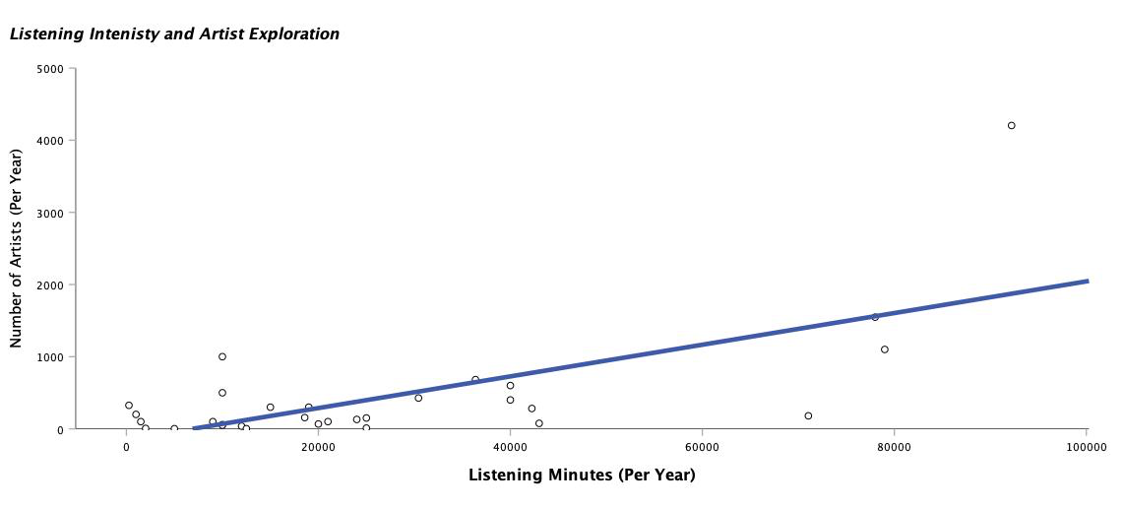
Results
Values ≠ Behavior
Minutes<—> Artists
r=.68, p<.001
Notes:
The results did not support the proposed hypotheses.
No significant relationships were found between personal values and any of the music listening variables.
This means that values did not meaningfully predict listening intensity, genre diversity, or repetition.
However, a strong positive relationship was found between listening minutes and number of artists, with a correlation of .68.
This suggests that people who listen more also tend to explore more artists.
Overall, the findings show that behavioral variables are related to each other, but not strongly explained by value orientations.”

Slide 8
Interpretation
Values= Abstract
Behavior= Contextual
Algorithms Shape Behavior
(Hesmondalgh & Campos Valverde, 2025; Walsh, 2024)
Notes:
One explanation for these findings is that values are abstract, while behavior is highly contextual.
Music listening depends on immediate factors such as mood, environment, and daily routines.
In addition, algorithms play a major role in shaping behavior.
Streaming platforms influence what people listen to through recommendations and playlists.
This means listening behavior is not purely driven by internal psychological traits, but by an interaction between the individual and the platform.”

Slide 9
Limitations and Conclusion
Limitations
Small Sample
WVS Bias
Self-Reported Data
Conclusion
Value ≠ Direct Predictors
Digital Context Matters
Are we choosing the music, or is it algorithm?
Notes:
There are several limitations to consider.
The sample size was relatively small, which may limit statistical power.
The value measures were adapted from the World Values Survey, which may introduce bias, and some participants perceived items as politically framed.
Finally, although behavioral data were based on platform summaries, they were still self-reported.
In conclusion, this study does not find evidence that personal values directly predict music listening behavior.
Instead, music consumption appears to be shaped more strongly by contextual and technological factors.
This highlights the complexity of understanding behavior in digital environments.”

Slide 10
THANK YOU
Chamorro-Premuzic, T., & Furnham, A. (2007). Personality and music: Can traits explain how people use music in everyday life? British Journal of Psychology, 98(2), 175–185.
Ferwerda, B., Tkalčič, M., & Schedl, M. (2017). Personality traits and music genres: What do people prefer to listen to? UMAP Proceedings, 285–288.
Haerpfer, C., et al. (2022). World Values Survey: Round Seven - Country-pooled datafile version 6.0.
Hu, R., & Pu, P. (2011). Enhancing collaborative filtering systems with personality information. RecSys.
Manolios, S., Hanjalic, A., & Liem, C. (2019). The influence of personal values on music taste. RecSys, 501–505.
Schäfer, T., & Mehlhorn, C. (2017). Personality and music preference. Music Perception.
Schwartz, S. H. (1992). Universals in the content and structure of values. Advances in Experimental Social Psychology, 25, 1–65.
Hesmondalgh, D., & Campos Valverde, R. (2025). Music in everyday life.
Walsh, J. (2024). Digital music consumption.
Notes:
Which raises the question: are we choosing the music, or is the algorithm choosing for us?”

