Slide 1


We Lost Agency or Agency was Lost:
Construction of (Non)agentic Positions
On Mental Health Subreddits
Honors Thesis in Psychology
Samantha Gerolmo-Feeney | gerolmo187@student.fus.edu
Psychology Program at Franklin University Switzerland
Supervisor: Professor Heidi Toivonen
PSY499H

Slide 2
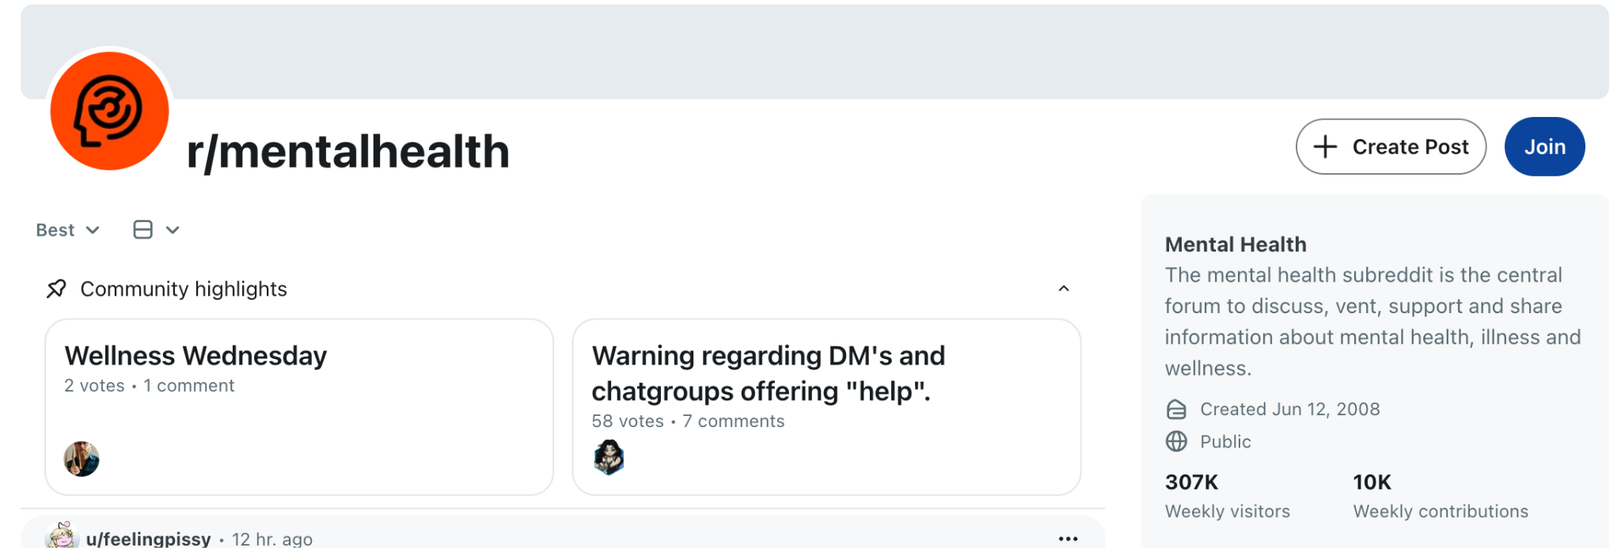
INTRODUCTION
VENT, DISCLOSE, SUPPORT, FIND FRIENDS, SEARCH FOR COPING STRATEGIES
(De Choudhury and De, 2014; Shaw, 2020; Statista Research Department, 2025)

Slide 3
INTRODUCTION; LITERATURE
Nonagency Construction
Toivonen et al. (2019, 2020)
Reddit Psychology Studies
De Choudhury & De (2014)
Proferes et al., (2020)
Andy (2021)
Non-agency in r/Depression using quantitative analysis
Simchon et al. (2023)
Discursive Psychology
Davies & Harré, (1990)
Edwards et al,. (1992)

Slide 4
INTRODUCTION; RESEARCH QUESTION
“How do individuals construct agentic and nonagentic positions on mental health Subreddits?”

Slide 5
METHODOLOGY
5 SUBREDDITS
DATA
DISCURSIVE PSYCHOLOGY
r/DEPRESSION | 998,608
r/ANXIETY | 647,120
r/SUICIDEWATCH | 452,111
r/MENTALHEALTH | 428,742
r/LONELY | 361,023
(Rani, Ahmed, and Subramani, 2024)
Closed subreddit threads
FRAMEWORK
Using the 10DT Model

Slide 6
METHODOLOGY
Table 1: Example of Nonagency and Agency Tool (10DT)
NAT2 | Others as Actor | “It is depressing. We are a product of society..” Upvote 13 r/MentalHealth | Some phenomenon/event is functioning as the actor, the client’s position is either not verbalized or is that of a victim, object, or stooge.
AT3 | Interiorization | “...because once it festers inside you for long enough it has roots deep down in your psyche and is extremely hard to get rid of…” Upvote 2 r/Depression | Accepting that the circumstances are related to who they are and their life, placing the psychological experience inside their mental realm and as part of them.

Slide 7

RESULTS; WHAT THE TOOLS REVEAL
MENTAL HEALTH AS….
→ Normal responce to society
“Soul-crushing”
“Civilization’s disease”
→ Symptoms only impact “us”
“We are”
“They are perfectly adapted”
NAT2
FATE/LUCK
TRAUMA
BIOLOGY
NAT5
SYMPTOMS PERSIST NO MATTER WHAT

Slide 8
RESULTS; FUNCTION OF CO-OCCURRENCE
“...It’s even worse when you do all those things (AT4) and still don’t get better (NAT5).”
Upvote 104
r/Depression

Slide 9
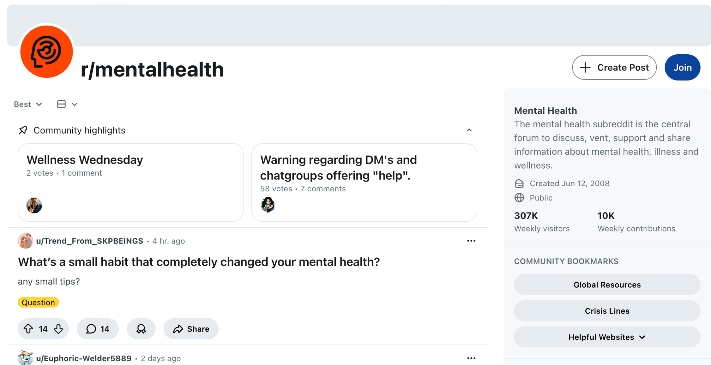
DISCUSSION
ROLE OF UPVOTES & DOWNVOTES
COLLECTIVE POSITIONS
LIMITATIONS
EVALUATION OF 10DT MODEL
(Graham & Rodriguez, 2021)

Slide 10
DISCUSSION; IMPLICATIONS
Echo-chambers
(Moreno et al., 2011; Oksanen et al., 2024)
Pandemic & post-pandemic
(Bengtsson & Johansson, 2022; Elkatmış, 2024)
Online disclosure & genAI
(Gere et al., 2025: Hoffman et al., 2025; Lu et al., 2021; Towner et al., 2022)

Slide 11
REFERENCES
Adams, N. (2022). ‘Scraping’ Reddit posts for academic research? Addressing some blurred lines of consent in growing internet-based research trend during the time of Covid-19. International Journal of Social Research Methodology, 27(1), 47–62. https://doi.org/10.1080/13645579.2022.2111816
Andy A (2021) Understanding user communication around loneliness on online forums. PLOS ONE 16(9): e0257791. https://doi.org/10.1371/journal.pone.0257791
Davies, B., & Harré, R. (1990). Positioning: The discursive production of selves. Journal for the Theory of Social Behaviour, 20(1), 43–63. https://doi.org/10.1111/j.1468-5914.1990.tb00174.x (philpapers.org)
De Choudhury, M., & De, S. (2014). Mental Health Discourse on reddit: Self-Disclosure, Social Support, and Anonymity. Proceedings of the International AAAI Conference on Web and Social Media, 8(1), 71-80. https://doi.org/10.1609/icwsm.v8i1.14526
Isern-Mas, C., & Almagro, M. (2025). Unmasking therapy-speak. Theoretical medicine and bioethics, 46(6), 465–489. https://doi.org/10.1007/s11017-025-09730-5
Moreno, M. A., Jelenchick, L. A., Egan, K. G., Cox, E., Young, H., Gannon, K. E., & Becker, T. (2011). Feeling bad on Facebook: depression disclosures by college students on a social networking site. Depression and anxiety, 28(6), 447–455. https://doi.org/10.1002/da.20805
Oksanen, A. (2020). Shared identity and shared information in social media: development and validation of the identity bubble reinforcement scale. Media Psychology. https://doi.org/10.1080/15213269.2018.1544910
Proferes, N., Jones, N., Gilbert, S., Fiesler, C., & Zimmer, M. (2021). Studying Reddit: A Systematic Overview of Disciplines, Approaches, Methods, and Ethics. Social Media + Society, 7(2). https://doi.org/10.1177/20563051211019004(Original work published 2021)
Rani, S., Ahmed, K., & Subramani, S. (2024). From Posts to Knowledge: Annotating a Pandemic-Era Reddit Dataset to Navigate Mental Health Narratives. Applied Sciences, 14(4), 1547. https://doi.org/10.3390/app14041547
Simchon, A., Hadar, B., & Gilead, M. (2023). A computational text analysis investigation of the relation between personal and linguistic agency. Communications psychology, 1(1), 23. https://doi.org/10.1038/s44271-023-00020-1
Toivonen, H., Wahlström, J., & Kurri, K. (2020). Constructions of nonagency in the clients’ initial problem formulations at the outset of psychotherapy. Journal of Contemporary Psychotherapy: On the Cutting Edge of Modern Developments in Psychotherapy, 50(1), 77–86. https://doi.org/10.1007/s10879-019-09417-8
Toivonen, H., Wahlström, J. & Kurri, K. (2019). Constructing nonagency at the beginning of psychotherapy: The 10DT model. Journal of Constructivist Psychology, 32(2), 160-180. https://doi.org/10.1080/10720537.2018.1433088

Slide 12
Thank you!
QUESTIONS?
Samantha Gerolmo-Feeney | gerolmo187@student.fus.edu
Supervisor: Professor Heidi Toivonen
PSY499 Honours

Slide 13
APPENDIX A
Table 1: Selected Subreddit Threads with User Engagement Statistics
Subreddit | Year Thread Began | Title | Users | Total Upvotes
r/SuicideWatch | 2023 | “Imagine getting only one shot at life and it's this” | 89 | 2,000
r/Anxiety | 2025 | “I finally stopped chasing people who never check on me — and now I feel both peaceful and alone” | 51 | 480
r/Lonely | 2025 | “Does anyone else just feel like sh*t Every. Single. Day?” | 81 | 677
r/Depression | 2020 | “Life doesn't "get better" unless you take actions to MAKE it better. But depression itself can make it impossible to act” | 105 | 3,300
r/MentalHealth | 2025 | “Is it really depression, or are we just finally realizing life in this system is soul crushing?” | 62 | 428

Slide 14
APPENDIX B
Table 2: Summary of Non-Reflective Nonagency Discursive Tools (Toivonen et al., 2019)
Agency Tools | Definition; The tool displays agency as….
Non-Reflective Positions
NAT1 | Dismissing | The issue is unrelated to oneself, any meaningful personal relationship with a supposed problem is denied or mitigated.
NAT2 | Others as Actor | Some phenomenon/event is functioning as the actor, the client’s position is either not verbalized or is that of a victim, object, or stooge.
NAT3 | Exteriorization | Experiences exist as their own entities and are not one’s own creation.
NAT4 | Not Initiating Action | Not being able to initiate action.
NAT5 | Not Stopping or Curbing Action | Not being able to stop what one is doing
NAT6 | Not Modifying Action | Not being able to make constructive choices.

Slide 15
APPENDIX B
Table 3: Summary of Reflective Nonagency Discursive Tools (Toivonen et al., 2019)
Reflective Positions
NAT7 | Noncognizance | Not understanding, knowing, noticing, etc. something about one’s experiences.
NAT8 | Reflection Dysfunction | Having chosen a way of acting that can no longer be sustained.
NAT9 | Discontinuance | The current actions/experiences are not meaningfully related to past/future.
NAT10 | Presumptive Positioning of Others | Not taking into account other persons’ perspective and being unable to coordinate meanings in a situation.

Slide 16
APPENDIX C
Table 3: Main Tools and Their Discursive Function across Five Subreddits
Tool | Discursive Function | Example from Data | Analysis
NAT2 | Environmental Factors | “...Its not in the cards for me to be happy…” Upvote 5 r/Lonely | Mental illness due to fortune
NAT2, AT7 | Collective Positioning | “As fate seems to take us to the lion's lair…Or maybe it's just the trials of the earth. Either way, we're left to question” Upvote 1 r/SuicideWatch | Collective positioning of nonagency with “us” and ‘we”
NAT5, AT4 | Symptoms Regardless of Action | “...No matter what I do, everything just goes to shit…” Upvote 2 r/SuicideWatch | Continuous mental health struggles (NAT5) justify no longer initiation actions (AT4)
AT4 | Supporting Others | “First, take a deep breath…” Upvote 5 r/Anxiety | Co-construction of agentic positions
AT7 | Express Shared Experiences | “...I truly don't understand why we feel this way, but I am sorry you're stuck in it too…” Upvote 3 r/Anxiety | Builds community through advice and support giving

Slide 17
APPENDIX D
“I agree. In the world where being evil and cold is normal, I would like to be the lunatic. When everything bad is popular, who wouldn't want to be unpopular…”
Upvote 1
r/MentalHealth

